Slide 1


ELECTRICAL AND ELECTRONICS ENGINEERING & USER INTERFACE AND DESIGN
IoT Based Smart Energy Meter

Slide 2
TEAM MEMBERS
D Praneeth CB.SC.U4aie24109
Raaman N CB.SC.U4aie24148
Meera S CB.SC.U4aie24133
Mithul A CB.SC.U4aie24135

Slide 3
INTRODUCTION
Monitoring electricity consumption manually can be time-consuming and inefficient. IoT (Internet of Things) offers a smart solution by enabling remote, real-time monitoring.
In this project, we will build our own IoT-Based Smart Energy Meter using an ESP32 microcontroller.
The energy data will be displayed on a custom-designed web interface.
Smart Energy Meters are gaining global attention due to their efficiency, automation, and cost-saving potential.
Let’s explore how we can leverage IoT to create a smarter way to track and manage electricity usage.

Slide 4
Objectives
Design and implement a real-time power monitoring system using an ESP32 microcontroller
Measure AC voltage accurately using the ZMPT101B voltage sensor
Measure AC current using the SCT-013 current sensor
Calculate real-time power consumption (Watts) based on the measured voltage and current
Display voltage, current, and power readings on a 16x2 LCD using I2C communication
Create a web page in which we can monitor all these values and display, power factor and our energy consumption bill too

Slide 5
Literature Review
S.No | Title | Basic methodology
1 | IoT Based Demand Side Management System (2024) | ESP32 microcontroller for monitoring and controlling. Current sensor (SCT-013) and voltage sensor (ZMPT101B) for measurements. Users can monitor energy usage, manage devices, and calculate bills via the Blynk 2.0 app.
2 | IoT Based Smart Energy Meter for Efficient Energy Utilization in Smart Grid (2018) | Integrates energy meter with ESP8266 12E Wi-Fi module, OLED display, current sensor, and relay driver. Uses LED pulses to calculate energy consumption (3200 blinks per unit). Data is processed using the Arduino IDE and uploaded to the ThinkSpeak cloud
3 | IoT-Based Smart Energy Meter (2023) | Energy consumption measured automatically with HLW8012 sensor. ESP32 microcontroller for data processing. Smartphone Integration by Virtuino Android app

Slide 6
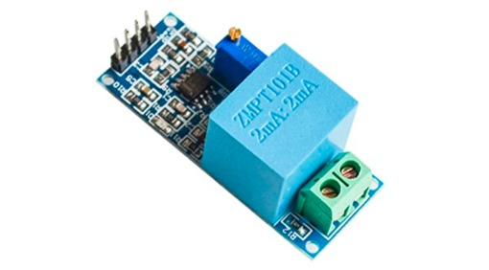
METHODOLOGY
1. AC Power Supply (230V AC Input)
Main electrical power source supplying 230V AC to the system
Sensors measure voltage and current from this power supply
Low-voltage components like ESP32 operate using regulated DC power from an adapter or voltage regulator
2. Voltage Measurement – ZMPT101B AC Voltage Sensor
The ZMPT101B is used for precise AC voltage measurement
It uses a high-precision voltage transformer and op-amp circuit to step down and isolate voltage
Voltage Sensing & Signal Conditioning
Contains a miniature transformer to detect AC voltage
Operational amplifier converts and amplifies output into a readable analog signal
Outputs an analog AC waveform, centred around 2.5V (in 5V systems)
ESP32 Processing & Calculations
ESP32 reads analog signal via ADC
Uses sampling and RMS calculations to derive actual voltage
Combines voltage with current for real-time power and energy usage calculations

Slide 7
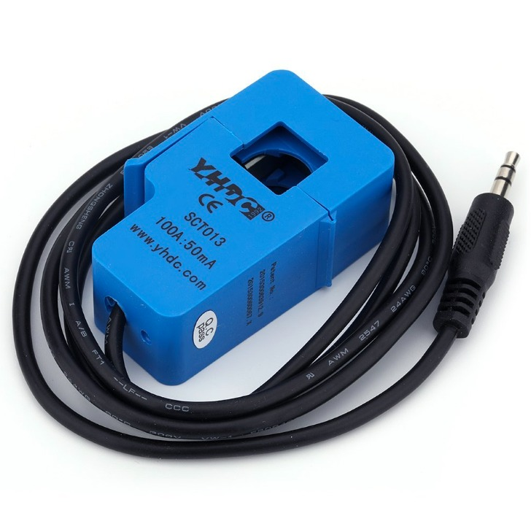
3. Current Measurement – SCT-013 Non-Invasive AC Current Sensor
SCT-013 is a clamp-type “non-invasive” sensor that measures current using electromagnetic induction
Working Principle
AC through a conductor generates a magnetic field
This induces proportional current in the internal coil
A resistor converts this induced current into an AC voltage signal
ESP32 Processing
ESP32 reads analog voltage via ADC
Applies RMS calculations to determine current in amperes (A)
Power & Energy Calculation
Voltage (from ZMPT101B) × Current (from SCT-013) × cos(Φ) = Real-time Power
Tracks cumulative energy usage over time

Slide 8
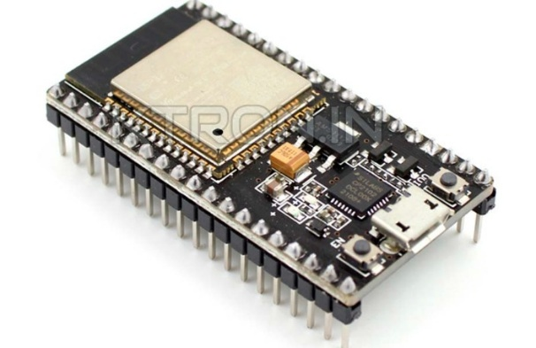
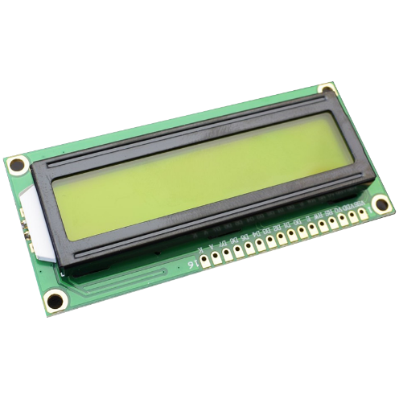
Lack of Brand Visibility
4. Data Processing – ESP32 Wi-Fi Module
Central controller handling all sensor inputs and calculations
Computes:
Power (Watts) = Voltage × Current × Power Factor
Energy (kWh) = Power × Time
Also functions as a Wi-Fi module
5. Local Display – 16x2 LCD
Displays real-time voltage, current, power, and energy
Connected via I2C for efficient data transfer
Useful for quick on-site monitoring without internet access
6. Data Transmission
ESP32 connects to Wi-Fi and hosts a web page.
Real-time values for are displayed the web page using the ESP32’s sent
Enables remote energy monitoring
Ineffective Digital Presence
Lack of Targeted Lead Generation
By leveraging strategic content, paid advertising, and personalized engagement tactics, we ensure that your marketing efforts are focused on reaching and converting the right audience.

Slide 9
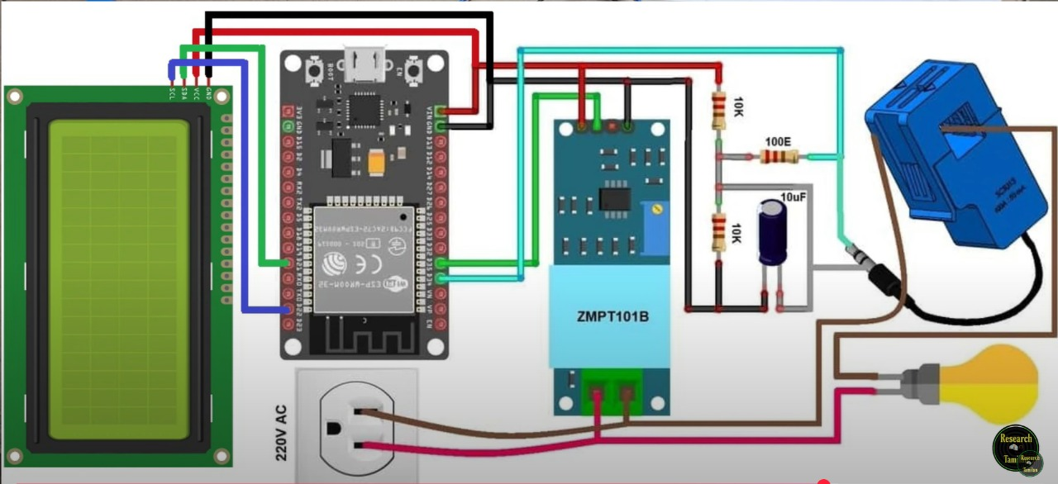
CIRCUIT DIAGRAM
CLIENT’S SATISFACTION
STATISTIC

Slide 10
CONNECTIONS
Component | Connected To | Connection | Reason
LCD 16x2 Display | ESP32 | GND → GND | To provide a common ground reference for the LCD and the ESP32.
 | ESP32 | VCC → VIN | Powers the LCD using the 5V supply from the ESP32 VIN.
 | ESP32 | SDA → GPIO21 (D21) | Data pin for I2C communication between the LCD and the ESP32.
 | ESP32 | SCL → GPIO22 (D22) | Clock pin for I2C communication between the LCD and the ESP32.
ZMPT101B Voltage Sensor | ESP32 | VCC → 3.3V | Provides operating voltage for the voltage sensor module.
 | ESP32 | GND → GND | Common ground to ensure proper signal referencing.
 | ESP32 | OUT → GPIO35 (D35) | Sends the analog voltage signal to the ESP32 ADC pin for processing.
SCT-013 Current Sensor | ESP32 | One Output Terminal → GPIO34 (D34) | Sends the current signal as an analog voltage to the ESP32 ADC pin.
 | ESP32 | Other Output Terminal → GND | Provides a common ground reference for the sensor.
 | Resistor (100Ω) | Across sensor output pins | Converts current signal to a voltage signal suitable for ADC input.
 | Capacitor (10µF) | Across resistor | Smooths the voltage signal and filters noise for stable ADC readings.
Voltage Divider | ZMPT101B → ESP32 | OUT → GND via 10kΩ | Reduces the output voltage to a level safe for the ESP32 ADC.
 | ZMPT101B → ESP32 | OUT → VCC via 10kΩ | Balances the voltage for accurate ADC readings.
ESP32 Power Supply | External Power Source | VIN → 5V | Provides 5V power supply to the ESP32 and its connected modules.
AC Supply | Load (Bulb) via SCT-013 | Live (L) → Bulb | Measures the live current flowing to the load.
 | Load (Bulb) | Neutral (N) → Bulb | Completes the AC circuit for the load.
With a global perspective, our marketing agency has proudly served multinational clients, delivering tailored strategies that transcend borders and cultures, ensuring consistent brand success on a worldwide scale.

Slide 11

UID PART
STATISTIC
Thynk Unlimited
1. Wi-Fi Configuration
ESP32 connects to network via SSID & password.
2. Web Server Setup
WebServer library runs on port.
Endpoint /data created to serve energy data.
3. Data Collection
EmonLib reads voltage, current, and power using sensors.
4. Data Formatting
Uses ArduinoJson to format sensor data into JSON.
5. Data Serving
ESP32 responds to HTTP requests (e.g., from browser/app) with JSON.
6. UI Fetching Data
UI (web/app) sends GET to /data.
Parses & displays energy stats in real time.

Slide 12
UID PART RESULTS
ESP32 created and hosted a web server for accessing values obtained by voltage sensor and current sensor.
Sent real-time commands to the HTML interface with JavaScript via ESP32
System worked reliably, updated at a good rate and displayed the final energy bill along with power factor.

Slide 13
RESULTS
The system successfully measured:
Voltage using the ZMPT101B voltage sensor
Current using the SCT-013 current sensor
Power was calculated in real time using voltage and current data
Output was displayed on a 16x2 LCD:
Live readings of Voltage (V), Current (A), Power (W) and Energy (kWh)
The output received was displayed on our webpage:
Readings displayed on the LCD display were a perfect match with the reading displayed in the webpage
Voltage, current, power, and energy were successfully displayed.
The web page displayed the power factor and the energy consumption bill as well

Slide 14
FURURE SCOPE
Smart Home Integration: Connect with systems like Alexa or Google Home for voice control.
Billing Integration: Link with utility systems for auto bill calculation.
Real-Time Alerts: Notify users of unusual consumption or faults via app or email.
AI Predictions: Use machine learning to forecast usage and suggest savings.

Slide 15
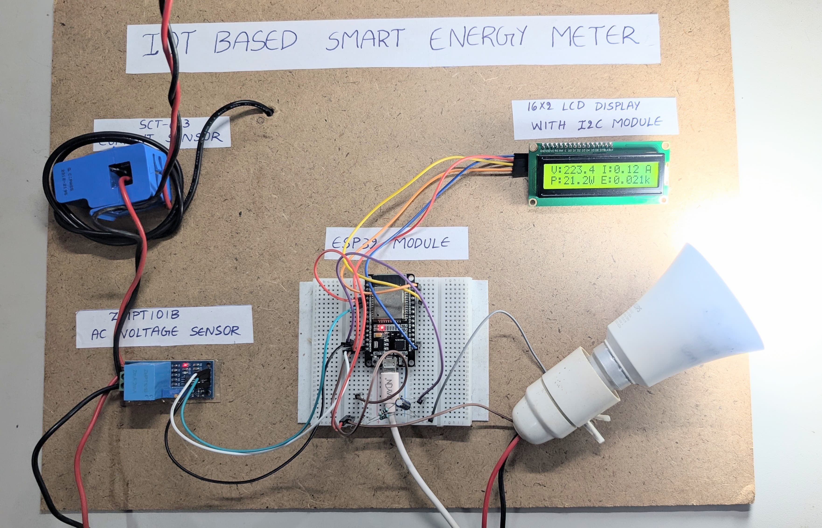
OUR CIRCUIT

Slide 16
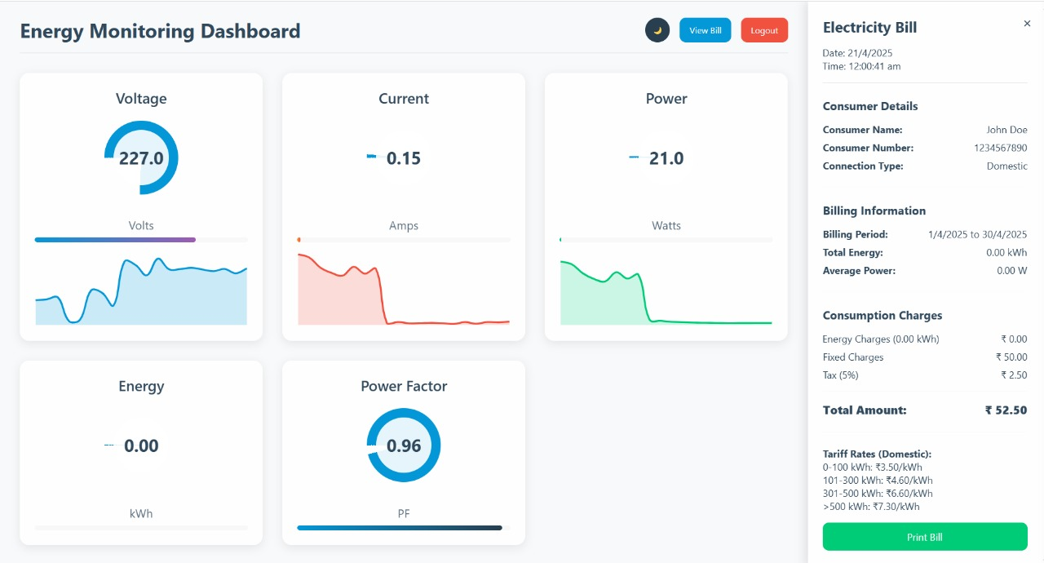
OUR WEB PAGE

Slide 17
THANK YOU

